Slide 1
Electron Trapping-Detrapping Soft Programming: Road to Trap-to-Trap Transition 20250630 진명

Slide 2





Trap-Assisted Soft Programming
Trap-Assisted Soft Program = Band-to-Trap + Trap-to-Band
BETOX
Band-to-Trap
Trap-to-Band
$$ν_{TBT}|TC_{o1}|$$
Detrapping Modeling
Channel
$ν_{TBT}|TC_{o2}|$
$$ν_{TBT}|TC_{o1}|$$
$$J_{in}$$
$ν_{TBT}|TC_{o2}|$
CTN

Slide 3
Trap-Assisted Soft Programming
1 x TBT
2 x TBT + n x TAT
(V_{G} = 0 V)
(V_{G} = 0 V)
2 x TBT
(V_{G} ~ 11 V)
0 < V < Vpgm : V ~ pass voltage!
Therefore… Soft Program = 2 TBT

Slide 4
Program/Read Disturbance – Reliability
…
Untarget Cell : soft program (~ms)
⸪ 100 – 200 WL program scheme 모두 적용될
동안 pass voltage (~11V) 노출
…
Target Cell : 일반적인 ISPP program (~μs)
…

Slide 5
Program/Read Disturbance – Reliability
Trapping-Detrapping effect
기존 Detrapping effect
Electron Trapping effect in ΔV_{th} distribution
(Soft Program)
Electron Detrapping effect in ΔV_{th} distribution
(Detrapping)
…
Erased Cells
gap margin (memory window)
degradation

Slide 6
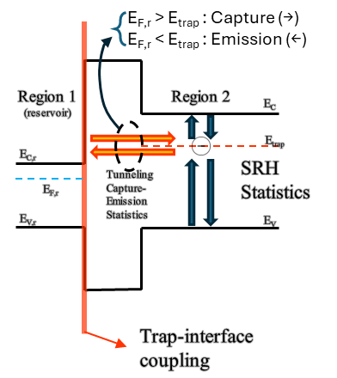
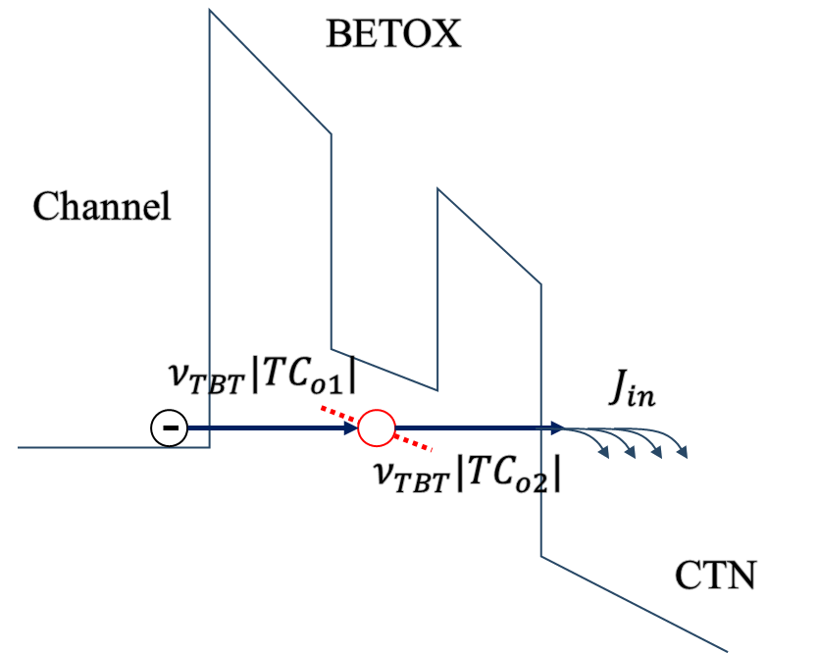
Modeling of Elastic TAT under V_{pass}
Trap-to-Band
Electron Detrapping
Band-to-Trap
Electron Trapping

Slide 7
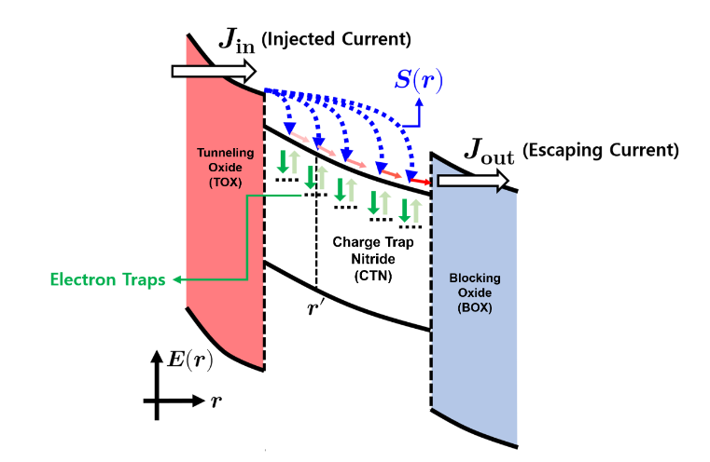
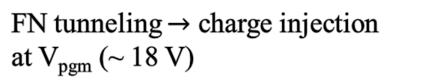
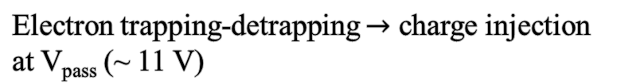
Difference from Program Operation
Amoroso / Verreck
Program Operation Model
FN tunneling $→$ charge injection
at V_{pgm} (~ 18 V)
Electron Trapping-Detrapping
(Soft program)
Electron trapping-detrapping $→$ charge injection
at V_{pass} (~ 11 V)

